Slide 2
Scalable Designs for Data Center Network
Fabric Aggregator
João Ferreira - Network Engineer - Facebook
Naader Hasani - Network Hardware Engineer - Facebook

Slide 3
Fabric Aggregator
Architecture and design principles
João Ferreira - Network Engineer - Facebook

Slide 4
Introduction
Anatomy of a region
Fabric Aggregator
  Overview
  Challenges
  Design principles
  Node implementation
  Operation and resiliency
Agenda

Slide 5
Overview
A network to interconnect more than 2 billion people

Slide 6
Anatomy of a region
Overview
Regions are a collection of a datacenter facilities in the same geographically proximity
Single region contain multiple fabrics
Each fabric interconnects a large number of racks
All fabrics in region are aggregated by a top level layer – Fabric Aggregation
Notes:
What to say:
All traffic from/to any fabric is processed by agg

Slide 7
Fabric Aggregator
Regional traffic
The aggregation layer is ”fully meshed” with all fabric planes in region
Majority of the traffic demand is inter-fabric intra-region (East-West >> North-South)
Inter-fabric flows can switch planes in this top level layer
Notes:
Ability to switch planes allows better resiliency

Slide 8
Fabric Aggregator
Inter-region traffic
Fabric Aggregation is also ”fully meshed” with upstream backbone nodes

Slide 9
Fabric Aggregator
Zoom in at region level
Fabric Aggregator is defined by a set of independent Aggregator “nodes”
All fabrics in region are fully meshed with all AGG “nodes” in region
Each AGG node “bin packs” north-south traffic demands from/to backbone
Subsets of AGG nodes are placed across different buildings to maximize general availability

Slide 10
Challenges
                All inter-fabric traffic is processed by Fabric Aggregation layer
Main growth vectors / pressure points:
Region size (# of fabrics / region)
Capacity demand from each individual fabric
Highly dependent on the service density in a particular DC and their
inter-dependency with other (remote) services
Notes:
Complement this slide with:
- Demand increase on 1 fabric indirectly affects the demand on all other fabrics and backbone, however, this inter-fabric demand growth
- Not all regions are the same

Slide 11
Aggregation node
Zoom in at node level
Radix of each AGG node is driven mainly by 4 axis:
# of fabrics per region
# of planes per fabric
Individual fabric width (# of edge pods per fabric)
# of backbone nodes in region
Each AGG node needs to:
Provide large amounts of capacity across all growth axis
Provide flexibility on region-specific requirements
Allow easy operations and high resiliency
Notes:
Some regions have different sizes in terms of # fabrics as well as in terms of capacity demands;

Slide 12

Design principles
“Disaggregated” vs ”monolithic” node solution
There are different approaches to this challenge:
Pursue radix expansion the on the classic “chassis-based” devices
Implement a disaggregated logical “node” with smaller/simpler devices
Reuse small and simple building blocks (e.g. Wedge100 + FBoss) in a disaggregated solution allows us to:
Iterate faster to very large “node” densities with up-to-date ASICs/optics technology
Use the same “building block” for all roles
Very small failure domains
Be efficient over time on the power and space footprints
This architecture principle can be easily reused in other layers of the network
Wedge100 platform available on:
http://opencompute.org/products/?keyword=wedge
Notes:
For 1) the challenge is keep up-to-date speeds and at the same time, provide large radix devices.
-> Iterate fast - new asic adoption or new optic adoption is very easy – build the basics very well and we can use it everywhere.
Fboss code is exercised extensively;
Very small failure domains – independent control planes.

Slide 13
Node implementation
Key aspects and assumptions
2-layer cross-connect architecture allows implementation of interesting “logical” node geometries
Specially if EW >> NS
                Downstream layer “localizes” all East-West traffic demands
                i.e. Inter-fabric/intra-region
                EW Traffic “localization” on the downstream layer is one of the most critical properties driving the system efficiency
                Upstream layer only processes North-South traffic demands
                i.e. inter-region traffic
                Standard routing with BGP
                Native FBoss BGPd implementation
Notes:
EW localization minimizes the DU / UU full mesh, which in turn minimizes the cabling complexity, and at the same time allows wider radix on the downstream layer.
Fboss BGPd handling “substantial” volume of routes

Slide 14
Node implementation
Standard “node” geometry within region
All “nodes” in region with the same m and n sizes.
However, different regions might require different geometries
Each downstream layer subswitch has
visibility to a subset of every single fabric in region
Every upstream layer subswitch has visibility to Backbone
Notes:
Backpack
However, it implies each downstream subswitch needs to visibility to all fabrics, otherwise upstream subswitch will be used as transit.

Slide 15
Node implementation
Some example geometries
                Extremely flexible solution
                Adjust m and n based on your environment requirements
                Some combination examples:
Sub-switch radix | #m | #n | Upstream capacity per “node” | Downstream capacity per “node” | ”nodes” per region | Total Upstream capacity | Total Downstream capacity
32@100G (Wedge100) | 2 | 1 | >>200G | 6.2T | 4 | >>800G | 24.8T
 | 8 | 4 | >>3.2T | 22.4T | 8 | >>25.6T | 179.2T
 | 16 | 4 | 6.4T | 44.8T | 8 | 51.2T | 358.4T
 | 24 | 8 | 6.4T | 57.6T | 16 | 102.4T | 921.6T
 | 28 | 4 | 1.6T | 78.4T | 32 | 51.2T | 2.508P
Note: when m < (subswitch radix / 2), the Upstream layer is over-sized. This might be useful if the upstream layer growth is driven by radix and not by bandwidth.
Notes:
Backpack
However, it implies each downstream subswitch needs to visibility to all fabrics, otherwise upstream subswitch will be used as transit.

Slide 16
Node implementation
Some example geometries
                Extremely flexible solution
                Adjust m and n based on your environment requirements
                Some combination examples:
Sub-switch radix | #m | #n | Upstream capacity per “node” | Downstream capacity per “node” | ”nodes” per region | Total Upstream capacity | Total Downstream capacity
32@100G (Wedge100) | 2 | 1 | >>200G | 6.2T | 4 | >>800G | 24.8T
 | 8 | 4 | >>3.2T | 22.4T | 8 | >>25.6T | 179.2T
 | 16 | 4 | 6.4T | 44.8T | 8 | 51.2T | 358.4T
 | 24 | 8 | 6.4T | 57.6T | 16 | 102.4T | 921.6T
 | 28 | 4 | 1.6T | 78.4T | 32 | 51.2T | 2.508P
Extremely asymmetric
North-South vs East-West
options
Note: when m < (subswitch radix / 2), the Upstream layer is over-sized. This might be useful if the upstream layer growth is driven by radix and not by bandwidth.
Notes:
Backpack
However, it implies each downstream subswitch needs to visibility to all fabrics, otherwise upstream subswitch will be used as transit.

Slide 17
Node implementation
Resiliency and operation
Ability to be very granular on how we operate the system:
Operate at “subswitch” level
Example, individual subswitch failure represents a a very small degradation of the total capacity
Operate at “node” level
For example, take all Upstream and Downstream subswitches in a given node out of service
Different tools have the notion of this hierarchy (“node” vs “subswitch”), so operation on different constructs is transparent

Slide 18
Node implementation
Resiliency and operation
Ability to be very granular on how we operate the system:
Operate at “subswitch” level
Example, individual subswitch failure represents a a very small degradation of the total capacity
Operate at “node” level
For example, take all Upstream and Downstream subswitches in a given node out of service
Different tools have the notion of this hierarchy (“node” vs “subswitch”), so operation on different constructs is transparent

Slide 19
Fabric Aggregator
Hardware Design
Naader Hasani - Network HW Engineer - Facebook

Slide 20
Agenda
Problem Statement
Design Approach
Cable Assembly

Slide 21
Problem Statement
Unit of bandwidth
  What we replicate to meet the overall bandwidth demand of a tier
  Applicable to all tiers of the data center network
  ”AGG Node” in Joao’s section
              Rack
                A physical container with space, power, and cooling constraints
              How to map the AGG Node to a rack?
                May not utilize the rack efficiently
                May not fit in one rack
Notes:
The ’unit if bandwidth’ can be built as a chassis with electrical backplane and multiple chassis may be stacked in a rack

Slide 22
Problem Statement
How to build the AGG Node?
  What do we need?
      Flexibility in east-west and north-south bandwidth ratios
      Scalability as the demands grow
      Iterability – must be quick to spin
  So where does “rack” fit in this picture?
      As a design parameter not a limiting constraint
Notes:
The east-west and north-south demands grow at different rates

Slide 23
Design Approach
So, how did we do it?
  Decided on DC-facing and BB-facing bandwidth ratios and the striping
  DU = 24; UU= 8 ➔ Fits in a rack
  Decoupled the backplane as a standalone component
  Ended up with 2 building blocks
      Switches -- DU and UU
      Topology -- Interconnecting the DU and UU layers
Topology disaggregation
Notes:
Striping refers to DU to spine switches as well as UU to BB switches

Slide 24
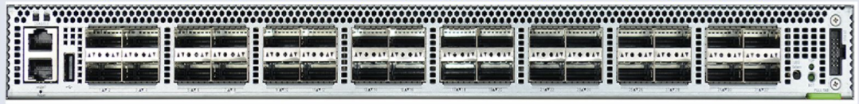
AGG Node
Cable Assembly
Wedge-100: 32x100G
Notes:
2 building blocks
Switches
CAU
Each circle is a radix 32 switch (Wedge)
Introduce notion of DU and UU again and emphasize 8 DU uplinks and 24 UU downlinks for listener to remember

Slide 25
Cable Assembly Unit -- CAU
Design Goals:
Serviceability above cost
Trivial install and connection
Options:
Optical
  Traditional Patch Panel (TRM) – manual process – density limit
  Robotically routed fiber – fully automated – higher fiber density (250um pitch)
Electrical
  DAC
Notes:
AGG Node is assembled on the floor – unlike a chassis
Serviceability highest – cost lowest
What options we chose to do this

Slide 26
Optical -- PSM
Notes:
I will dwell on this option to highlight a few common design principals
6 RU
Simple straightforward assembly in DC

Slide 27
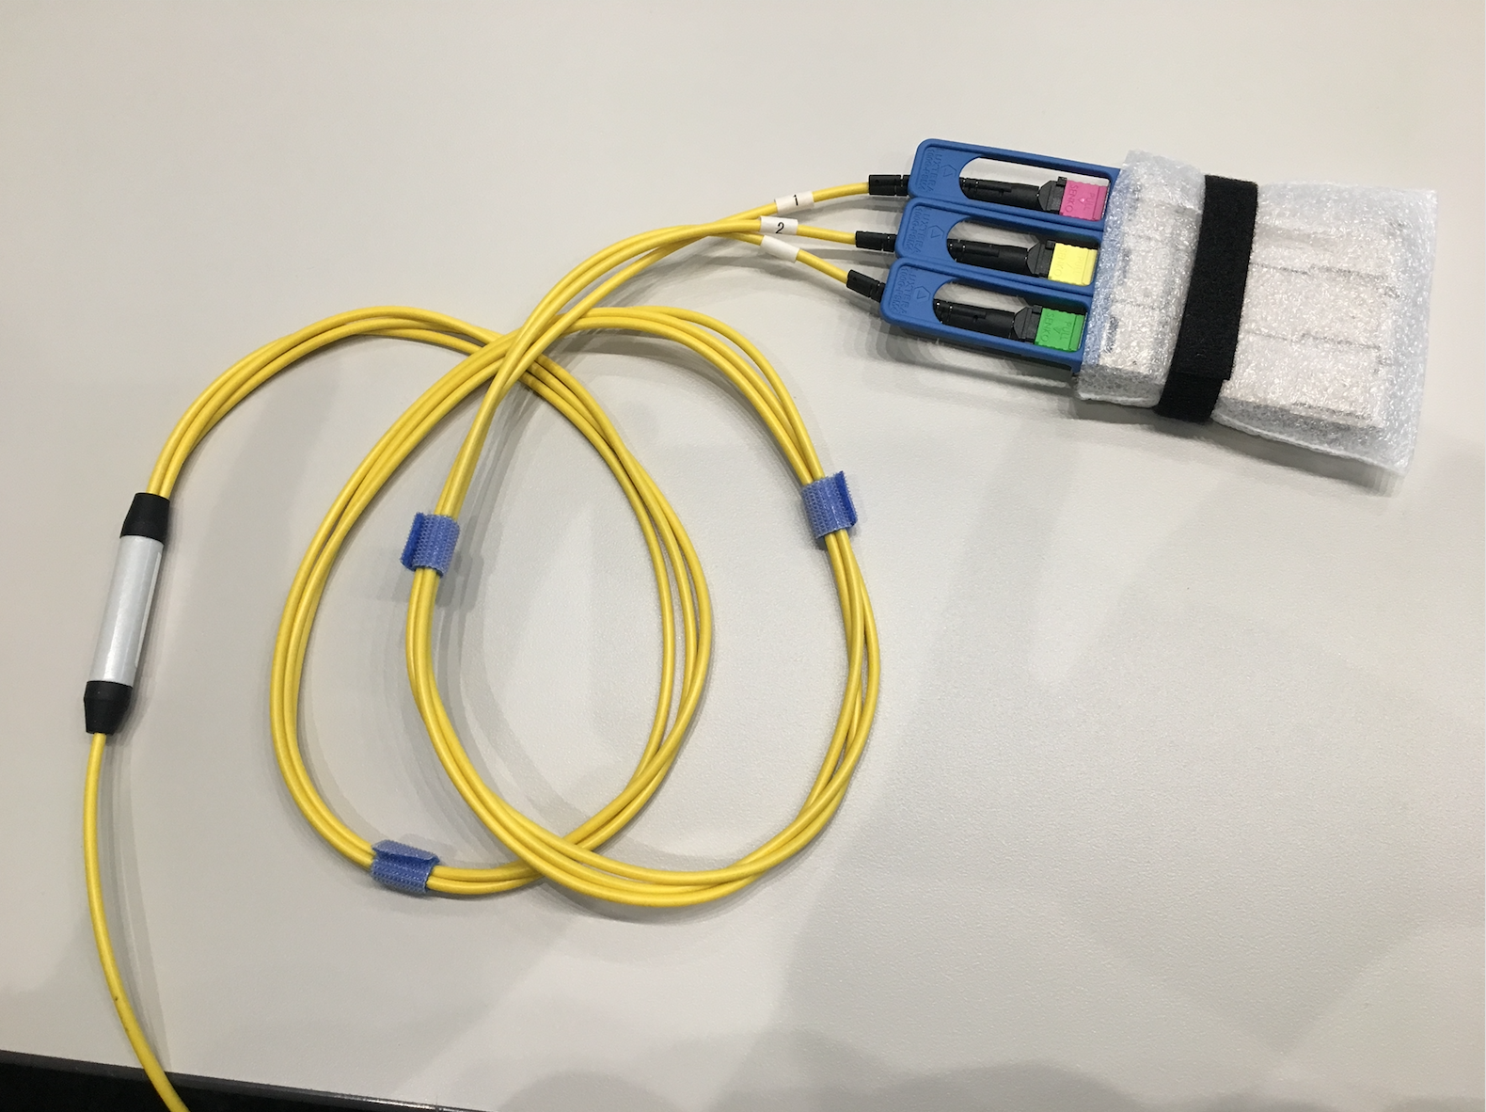
Optical -- PSM
Notes:
Design goal: Simplify install and maintenance
Ganged modules; Minimize number of fiber matings
The break out piece connects to Wedge ports

Slide 28
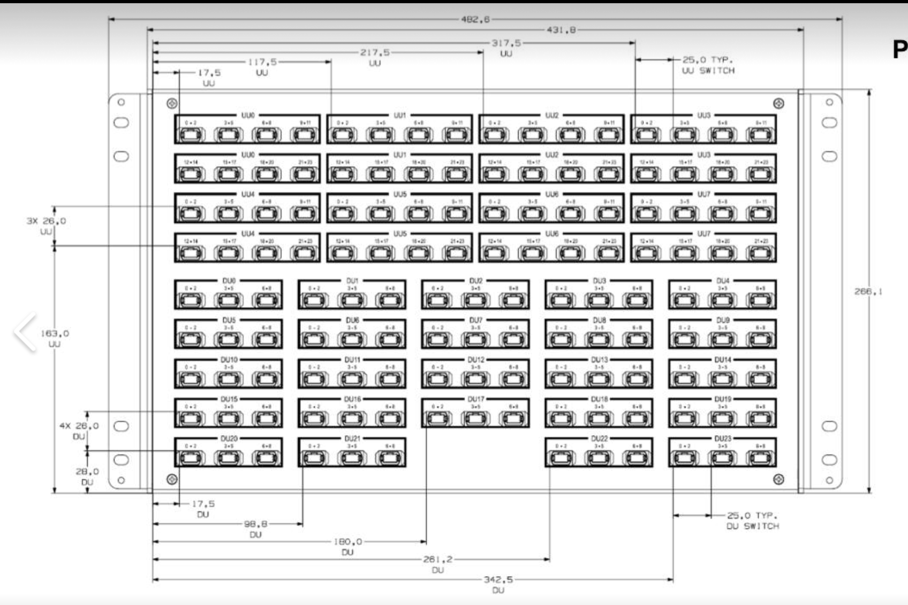
Optical -- PSM
8 x 3 = 24
UU downlinks
3 x 3 = 9 (8 are used)
DU uplinks
Notes:
8 UU each 24 downlinks
24 DU each 8 uplinks

Slide 29
Optical -- PSM
Notes:
FlexPlane Technology – fine pitch (250um) robotically routed fiber on substrate over an adhesive layer
Manufacturing lead time = 3 months
Why: High fiber density -> larger backplane port count

Slide 30
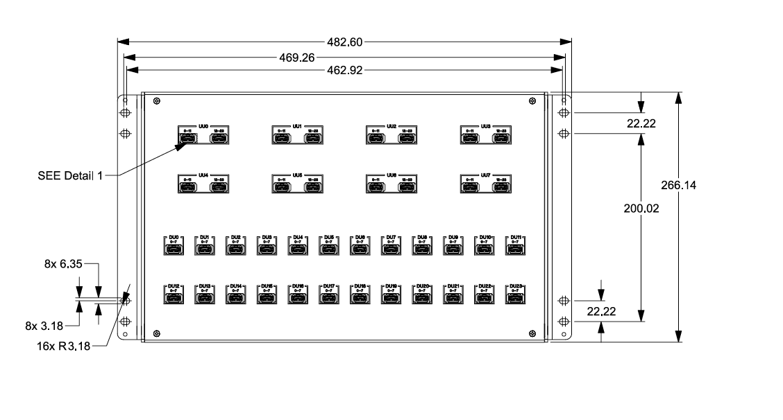
Optical – CWDM4
2 x 12 = 24
UU downlinks
1 x 8 = 8
DU uplinks
Notes:
6 RU
Same Flex-Plane technology
Different cables for du and uu:
- 12 break-outs for UU
- 8 break-outs for DU

Slide 31
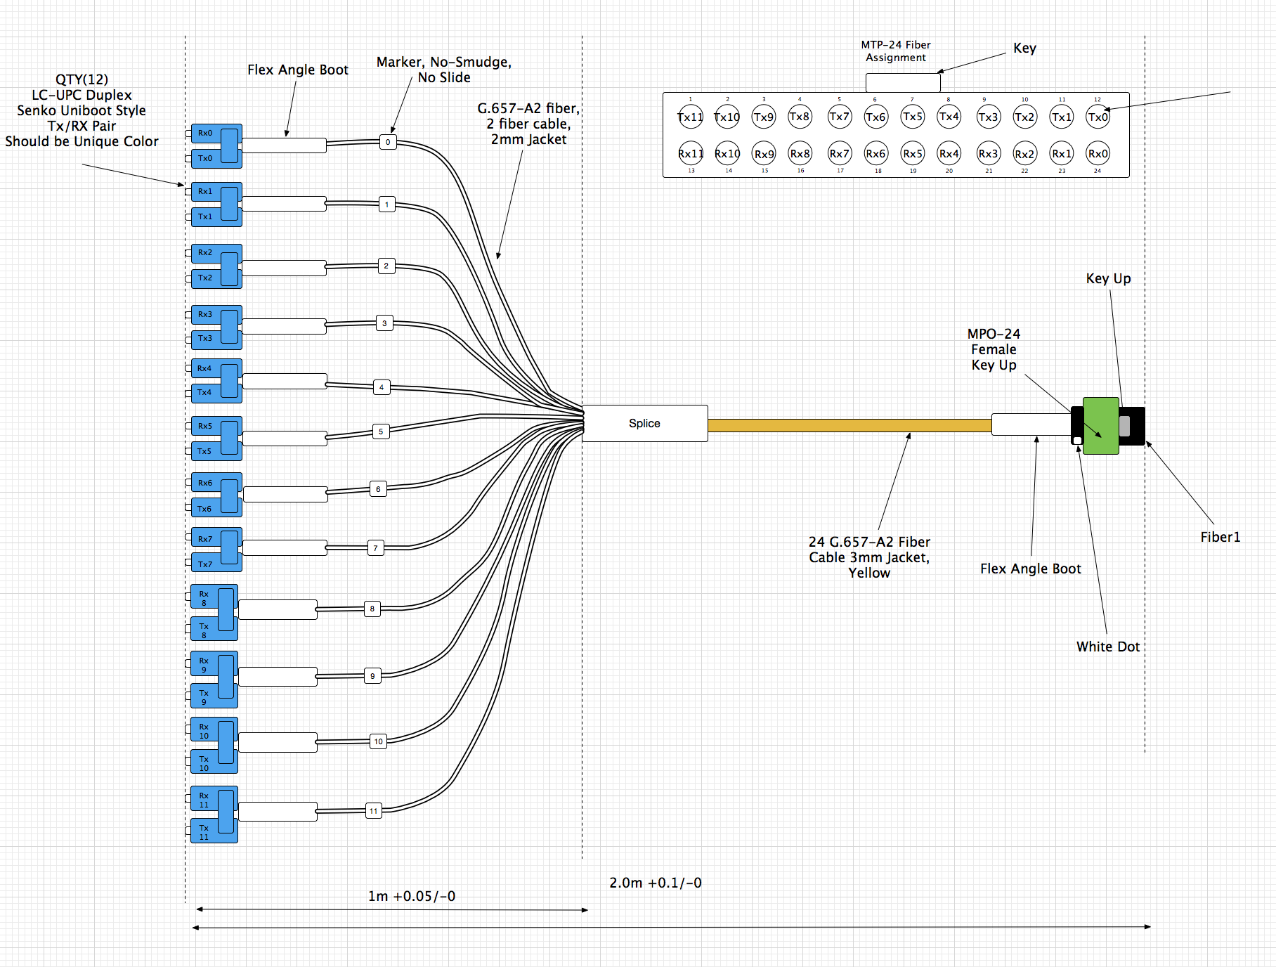
Optical – CWDM4
Notes:
UU cable shown
- 12 break-outs for UU

Slide 32
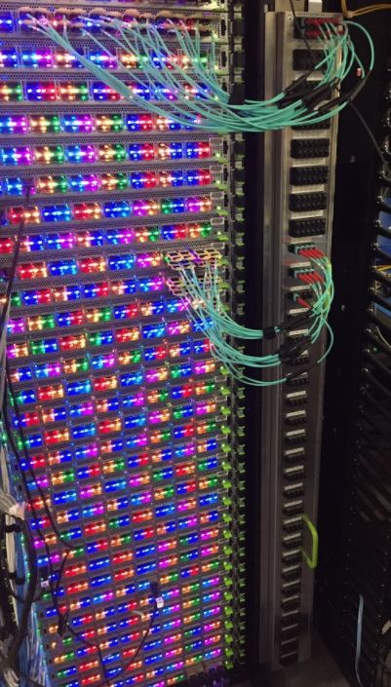
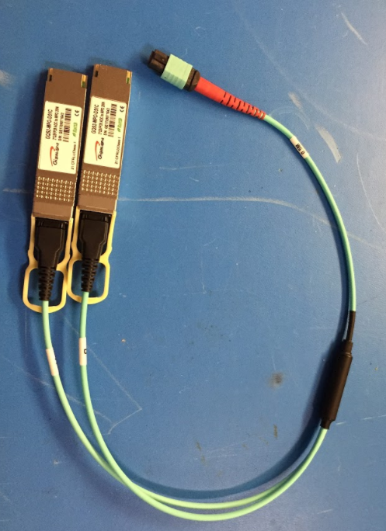
Optical – Pigtail AOC
Notes:
Side plane design – does not occupy RU space
Dual pigtail AOC
Two 100G QSFP transceivers share the same MTP24 (16 used out of 24)

Slide 33
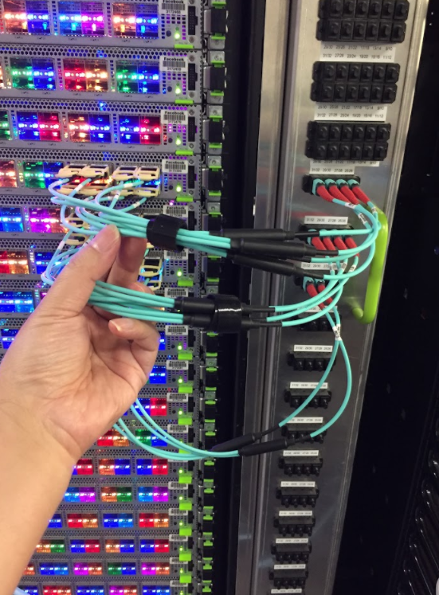
Side Plane
UU Panel
DU Panel
P1
P3
P5
P7
P9
P11
P13
P15
P17
P19
P21
P23
P25
P27
P29
P31
P2
P4
P6
P8
P10
P12
P14
P16
P18
P20
P22
P24
P26
P28
P30
P32

Slide 34
DAC
Similar to AOC design
Side plane
  3 modules using Aluminum to keep the weight down

Slide 35
Side By Side
Backplane Options
Backplane | Cost | Scalability | Operation | Power
PSM4
CWDM4 | - | + Multi rack span | + | -
Pigtail AOC
DAC | + | - | - Heaviest | +
Notes:
This is what we chose to operationalize first

Slide 36
Summary
We built a large radix switch with
  Proven switch building block = Wedge 100
  A cable assembly unit
Validated
  Manufacturability
  Operationalization

Slide 37

Notes:
Big picture taking all the slide, with no text

